Slide 1


Data Science Capstone Project
-by Saurabh Shahi
shahisaurabh@gmail.com
Data Science Capstone Project

Slide 2
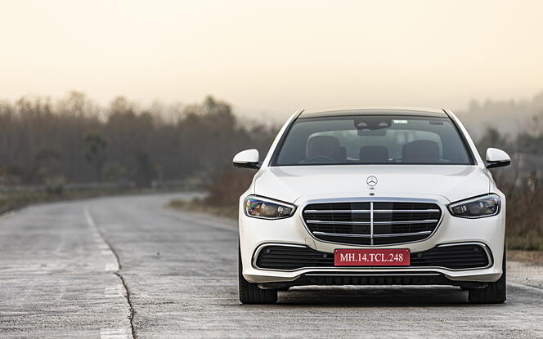
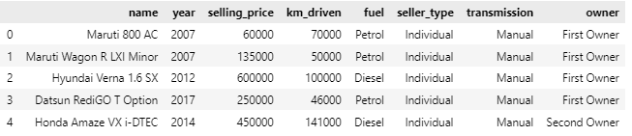
DataSet: Car Details
We have different columns namely:
Name : Brand and Name of the car.
Year : Make Year.
Selling Price : Price of the car.
Km_driven : How many kilometers the car has been driven.
Fuel : What fuel it consumes, Petrol, Diesel, CNG etc.
Seller Type : Who is selling the car.
Transmission : Whether the car is Automatic or Manual.
Owner : How many owners the car had.

Slide 3


Objective
Objective of the project is to analyze the data and predict the selling price for the used cars.
Python Libraries Used
For Data Preprocessing: Pandas, Numpy, Matplotlip.pyplot, Seaborn
For Encoding : Scikit-learn (OneHotEncoder, PipeLine, ColumnTransformer)
For Machine Learning Model : Scikit-learn (Linear Regression, Kneighbors, BaggingRegressor, AdaBoost, RandomForest, DecisionTree)
For Transporting Data : Pickle
For App Building : Streamlit

Slide 4
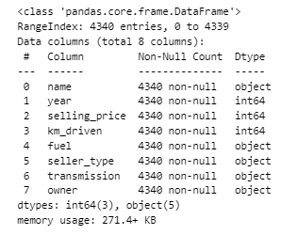
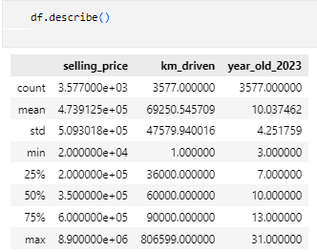

Data Pre-Processing
Imported the data to python(3.9.13)
Handling the null and duplicated values.
Getting data insights.
Created a new column, ‘Company’ and ‘Year Old’.
Performed Exploratory Data Analysis(EDA).
Checked all the column’s data.
Did Encoding/ Scaling.

Slide 5
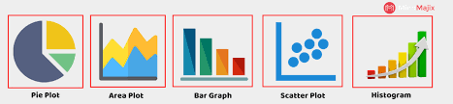
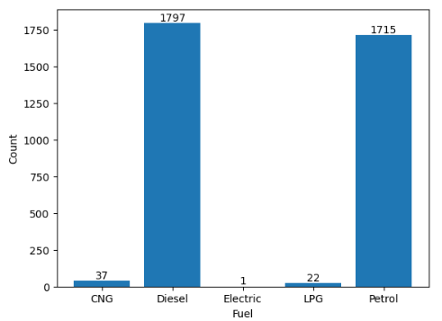
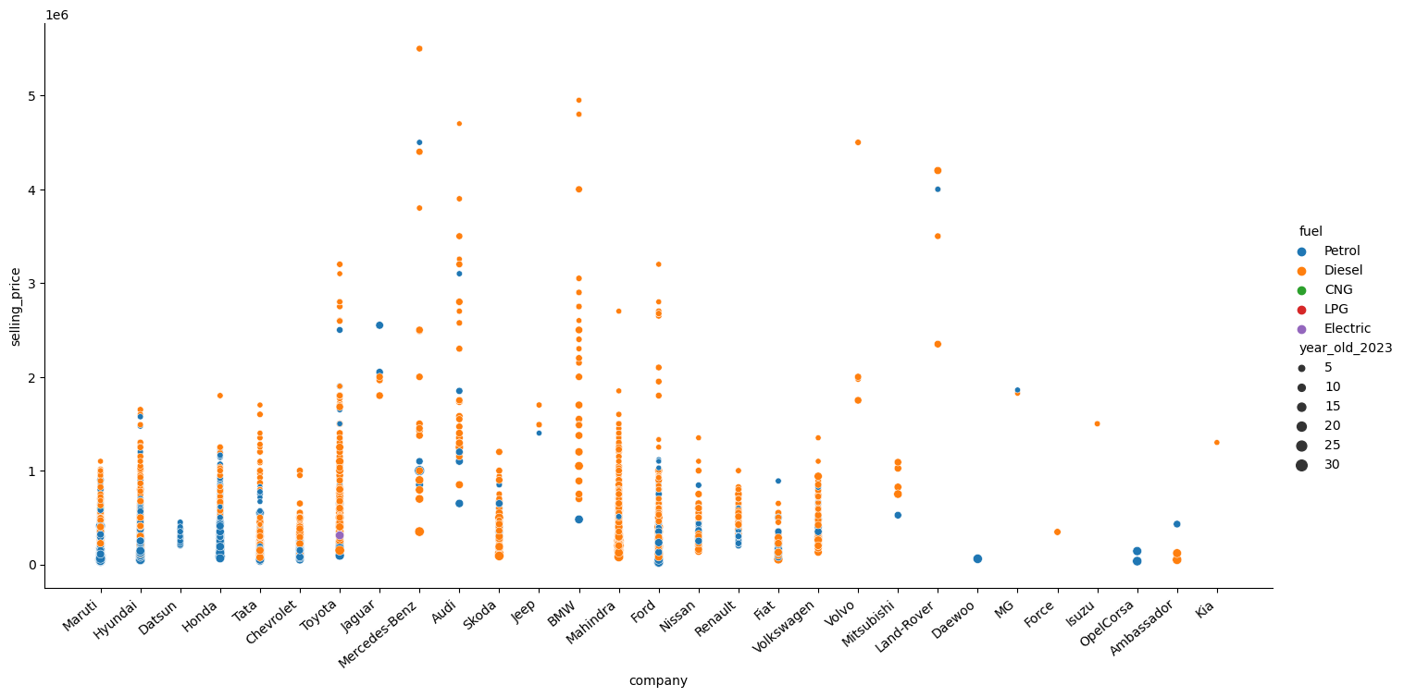
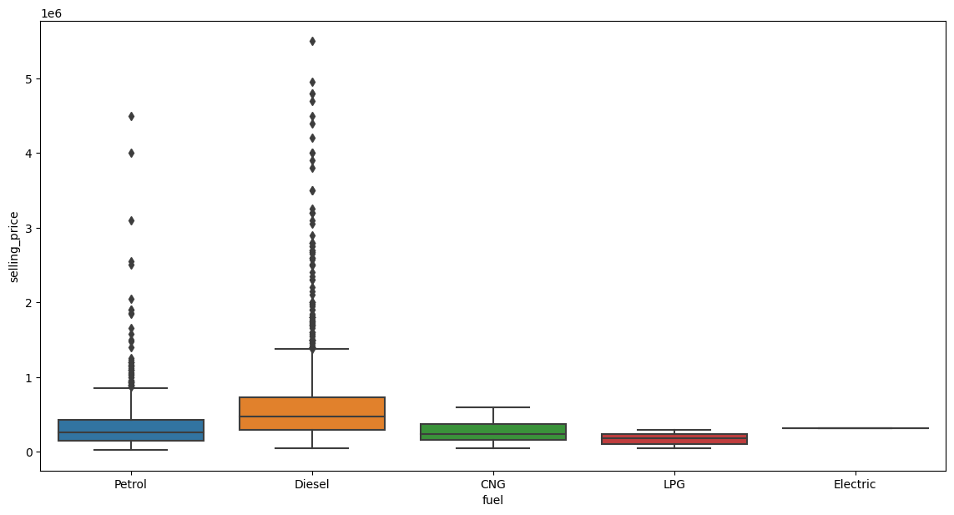
Graphical Analysis
Created graphs which helped to understand the patterns and the correlation between the data given.

Slide 6

Insights
Data is very low correlated.
Diesel cars are little expensive than other.
More Diesel and Petrol cars there for resale.
More the car ages less the resale price.
Test drive cars have more resale value.
Less driven car more the price and vice versa.
The most influential factors affecting the price of a car are brand, model, age, transmission, km_driven and owner.
Maruti has most cars for resale(1070) followed by Hyundai(637).

Slide 7

Machine Learning Model and Web App Links
GitHub : Model_Car_Price_Predictor
StreamLit : App
Graphical Analysis : Graphs
Linkedin

